Slide 1
Session:12 Parameter Passing in Java
KLEF OOPS BES-1

Slide 2
Session Outcomes
At the end of this session,
To be able to understand how to pass an object to method and to return objects from methods.
To be able to differentiate between call by value and call by reference.
KLEF OOPS BES-1

Slide 3
Calling a Method
Each time a method is called, the values of the actual arguments in the invocation are assigned to the formal arguments
int num = min (2, 3);
static int min (int num1, int num2)
{
int minValue = (num1 < num2 ? num1 : num2);
return minValue;
}
KLEF OOPS BES-1

Slide 4
Method Control Flow
A method can call another method, who can call another method, …
main
min(num1, num2, num3)
println()
min(1, 2, 3);
…println(…)
KLEF OOPS BES-1

Slide 5
Parameter Passing in Java
There are different ways in which parameter data can be passed into and out of methods and functions.
Let us assume that a method B() is called from another method A(). In this case A is called the “caller method” and B is called the “called method or callee method”.
The arguments which A sends to B are called actual arguments and the parameters of B are called formal arguments.
KLEF OOPS BES-1

Slide 6
Types of parameters
Actual Parameter : The variable or expression corresponding to a formal parameter that appears in the function or method call in the calling environment.
Syntax:
function_name(variable name);
Formal Parameter : A variable and its type as they appear in the prototype of the function or method.
Syntax:
function_name(datatype variable_name)
KLEF OOPS BES-1

Slide 7
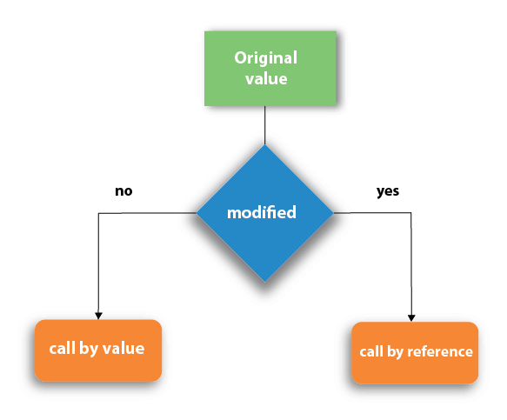
Parameter Passing Techniques in Java
Call by value
Call by reference
KLEF OOPS BES-1

Slide 8
Call by Value
Call by value method copies the value of an argument into the formal parameter of that method. Therefore, changes made to the parameter of the main function do not affect the argument.
In this parameter passing method, values of actual parameters are copied to function's formal parameters, and the parameters are stored in different memory locations. So any changes made inside functions are not reflected in actual parameters of the caller.
KLEF OOPS BES-1

Slide 9
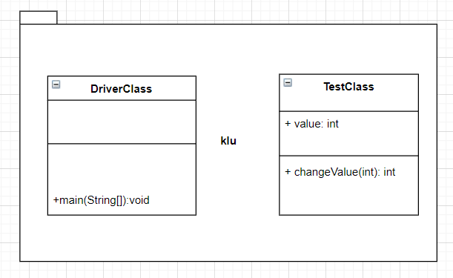
Call by Value-Class Diagram
KLEF OOPS BES-1

Slide 10
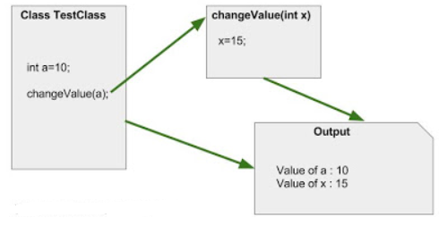
Call by Value- Example
KLEF OOPS BES-1

Slide 11
Call by Reference
Call by reference method copies the address of an argument into the formal parameter. In this method, the address is used to access the actual argument used in the function call. It means that changes made in the parameter alter the passing argument.
In this method, the memory allocation is the same as the actual parameters. All the operation in the function are performed on the value stored at the address of the actual parameter, and the modified value will be stored at the same address.
KLEF OOPS BES-1

Slide 12
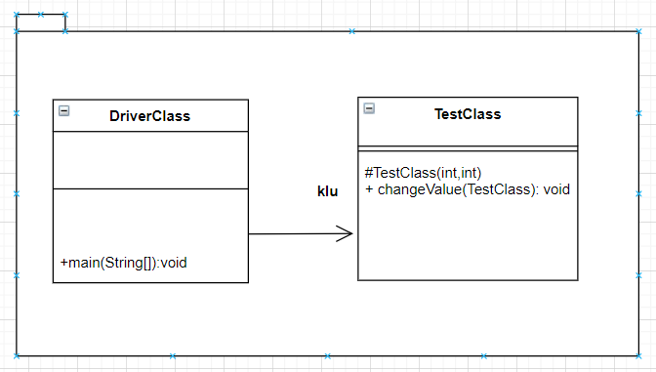
Call by Reference-Class Diagram
KLEF OOPS BES-1

Slide 13
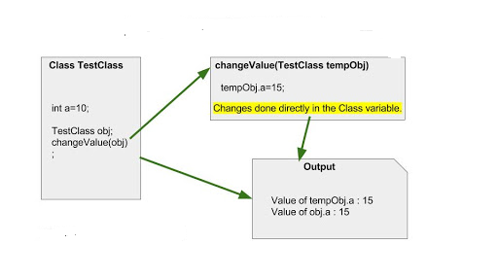
Call by Reference-Example

Slide 14
Practice Problem-1
Object as Argument
Create a class Test with equals () method which compares two objects for equality and returns the result i.e., either true or false (Note: equals () methods should take an object as an argument)
KLEF OOPS BES-1

Slide 15
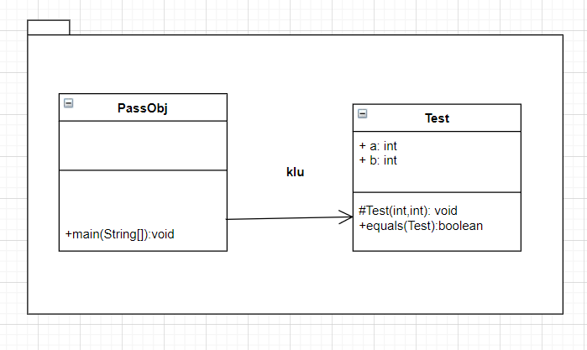
Practice Problem-1 Class Diagram
KLEF OOPS BES-1

Slide 16
Practice Problem-2
Returning object from a method
Create a class Test with incrByTen () method which returns an object after incrementing the value by 10 than the value in the invoking object.
KLEF OOPS BES-1

Slide 17
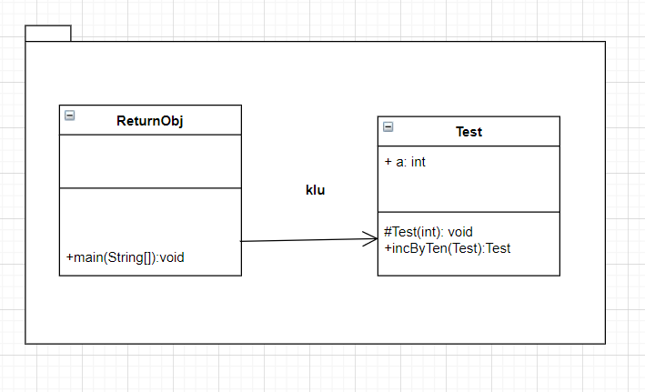
Practice Problem-2 Class Diagram
KLEF OOPS BES-1

Slide 18
Summary
In Call by value method original value is not modified whereas, in Call by reference method, the original value is modified.
In Call by value, a copy of the variable is passed whereas in Call by reference, a variable itself is passed.
When a primitive type is passed to a function, it is done by use of call-by-value. Objects are implicitly passed by use of call-by-reference.
A method can return any type of data, including class types that you create.
KLEF OOPS BES-1

Slide 19
Thank You

